Slide 1
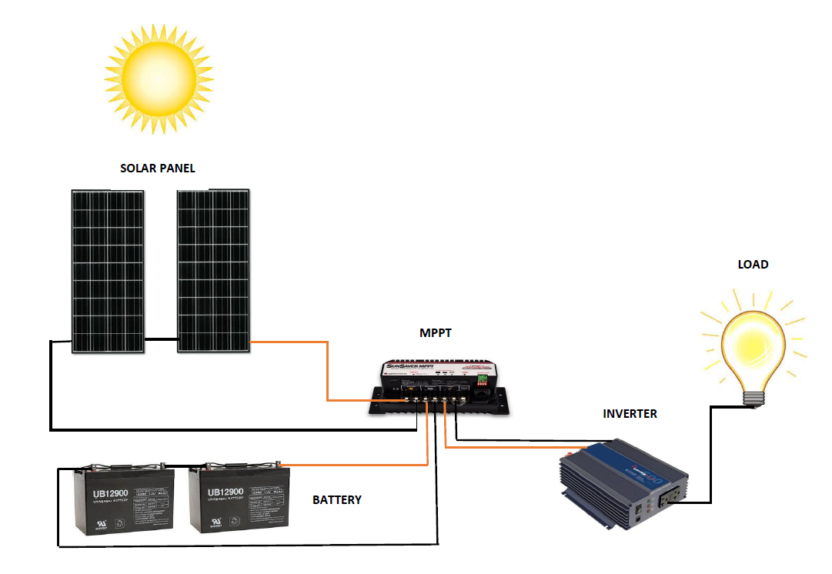
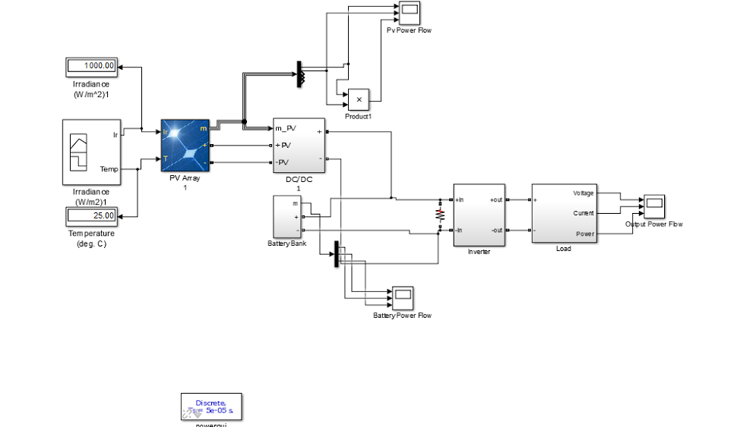
Stand-Alone Solar PV Energy System
Faculty advisor: Venktaramana Ajjarapu Team members: Dylan Hird, Jeremy Helgeson, Xiangpeng Yang
Background
Concept Sketch
Technical Details
Energy is a basic necessity for human activities and for economic and social development. This project is to design and implement a solar PV system to generate electrical power by using sun light.
All simulation was done in MatLAB/ Simulink using the simscape specialized technology library
Each step of the physical system is modeled in the simulation as accurately as possible
Problem Statement
d
Our group set out to help further the knowledge of students and create a friendly learning environment.
We created a system with safety and accessibility in mind to help provide for future engineers and people.
During our used the resources to create both physical and simulation base learning
Design Requirements
Block Diagram
The basics of our project is split into four different sections
Physical Design
Power generation by PV
DC to DC voltage conversion and MPPT
Energy Storage/Battery
Dc to AC voltage conversion
output/Load
Real Time System Information
Voltmeter / Ammeters/Watt Meter
Irradiance Sensor
Temperature sensor
Labview system
Simulation
Simulink system equivalent
Lab Manuel for system recreation
Step by step process
Deliverables
Work was also done using Labview attached to a NI controller to read real time statistics from our system
All of the system’s parts were safely connected to ensure no students can get hurt
Additionally the lab manual that has been created shows each step to recreate the system and explain each part
Explanation of Functional Module
Technical Details
Solar panel is used to collect sun light to generate electric current
Battery is used to supply power to inverter
MPPT is used to make system to reach its maximum power point
Inverter is used to change DC current to AC current
Load represents the device using electric power that is connected to this solar PV system
Test cases for the system
Inverter off (no load) test (Battery charging)
Inverter on test (Battery discharging)
Inverter on, solar panel on and battery off test (Battery discharging)
Inverter on, solar panel off and battery on test (Battery discharging)
Some cases were dependent on light from the Sun which is out the control of the user.
Intended Users and Uses
Students learning about the design and information for PV systems
Supplying power to people in third world countries and remote area
Helping improving environmental condition
Saving limited nonrenewable energy resources
Explanation of System Connection
When inverter is turned on, both current of solar panels and batteries goes into MPPT and inverter
When inverter is turned off, current from solar panels will go into batteries and charging batteries

