Slide 1
Stand-Alone Solar PV Generation System
Advisor and client: Venktaramana Ajjarapu
Group Members:
Dylan Hird
Jeremy Helgeson
Xiangpeng Yang

Slide 2
Key Concept
Use solar generation to provide for 400 W load
Design a lab document based on solar generation system for future students
Operate under variety of weather conditions
Self-reliant, off-grid

Slide 3
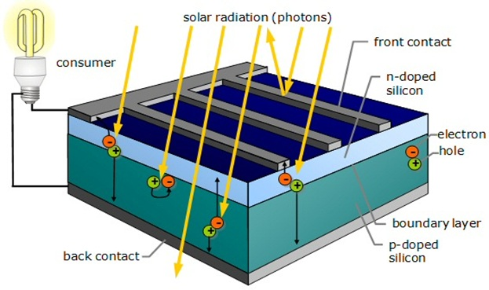
Introduction
Sunlight strikes the cell to raise the energy level of electrons in semiconductor material (such as silicon) and free them from their atomic shell
A metal grid on the surface collects electrons

Slide 4
Block Diagram

Slide 5
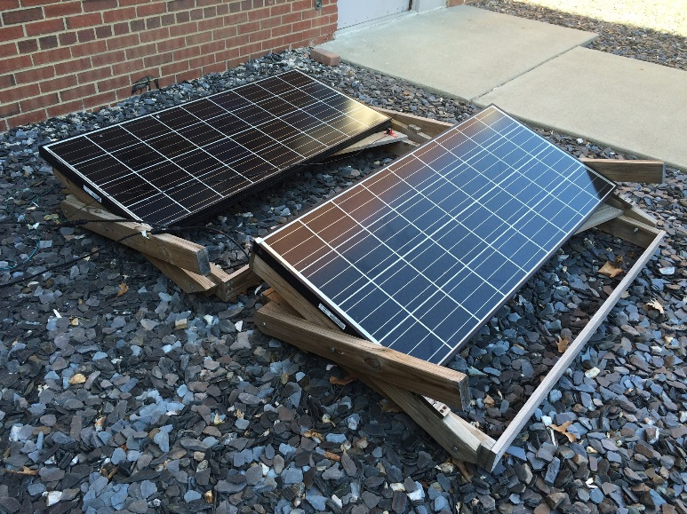
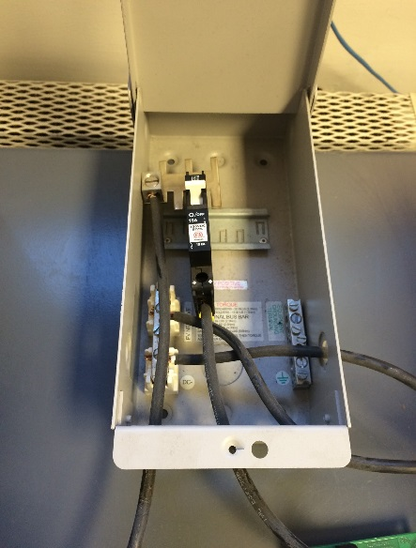
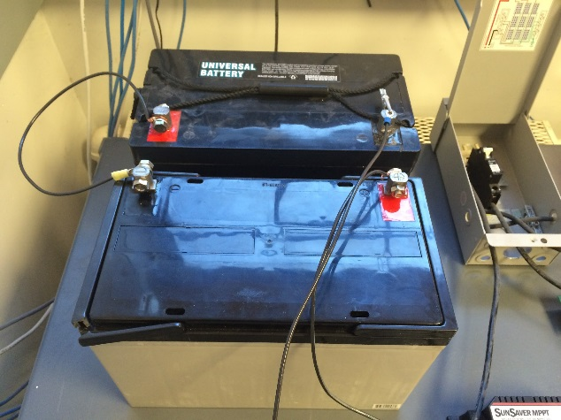
System Design
Two solar panels connected in series
Connected via solar combiner to MPPT
Two 12V batteries connected in series that sets load voltage level at 24 Vdc
Connected to MPPT by wires
Solar panels
Solar combiner
Batteries

Slide 6
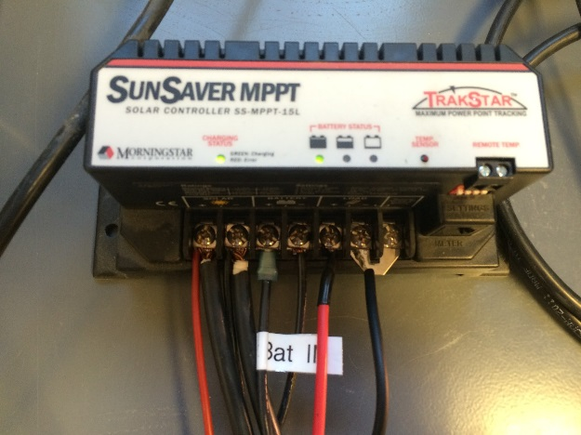
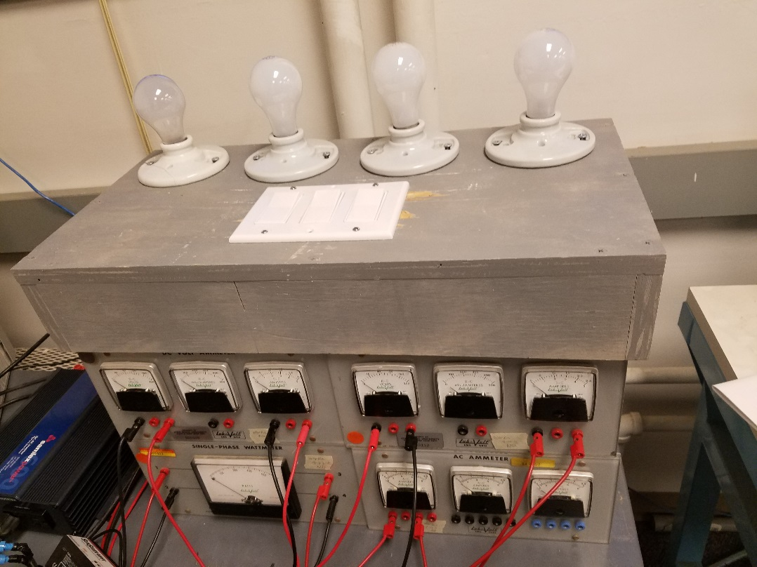
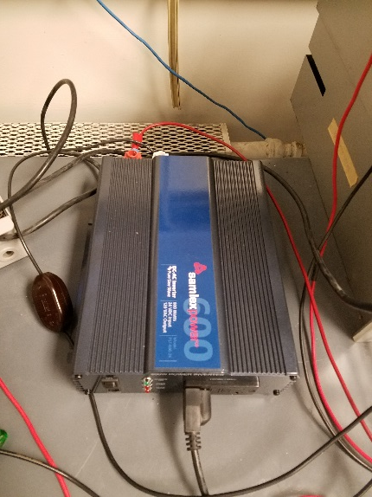
System Design
The 600W rated inverter converts current from DC to AC and supplies to load
Connected to load terminals by wires
MPPT makes the system run at its maximum power point
A variable AC load connected at the end of the system
Inverter
MPPT
AC load

Slide 7
Concept Sketch

Slide 8
Detailed Design
Solar Generation
2 x Kyocera Model KD135GX-LPU in Series (35.4V, 7.63A: 270W)
Morningstar SS-MPPT-15L 15 Amp Maximum
Battery
2 UB12900 batteries in series 12V/90Ah
Inverter
Samlex PST-600-24, rated for 600W
Load
4 100W light bulbs in series and switches allow for easy and convenient testing

Slide 9
System Cost
 | Size/model | $/unit | # | Total($)
Inverter | 24V 600W/Samlex PST-600-24 | 220.82 | 1 | 220.82
Battery | 12V/UB12900 | 162 | 2 | 324
Fan | RDH1232B | 0.99 | 1 | 0.99
MPPT | Solar controller ss-mppt-15l | 195.87 | 1 | 195.87
Solar panel | 59.1''x26.3''x1.8''/KD135GX-LPU | 276.38 | 2 | 552.76
 |  |  |  | 1294.44

Slide 10
Previous Team’s Work
Basic outline of project (had most of the components purchased)
We had little access to the previous team’s designs and simulations
We increased the safety of their original design by purchasing better connector for the wires.

Slide 11
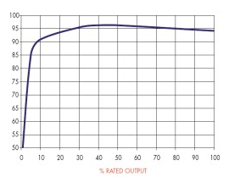
How we reached our current design?
We built off the original design by the previous group
Wanted higher efficiency from the system so we decided to purchase an inverter with a lower rating.

Slide 12
Potential Risks & Mitigation
People may be exposed to system components
Risk of reduction in electricity generation because of weather

Slide 13
Test Plan
Hardware test
Test method: Meters and sensors
Software: LabVIEW
Data measurement table
 | Solar Panel | Battery | Inverter | Load
Battery Discharging case | ○ | ○ | ○ | ○
Only Solar Case | ○ | ○ | ○ | ○
Only Battery Case |  | ○ | ○ | ○
No Load Case | ○ | ○

Slide 14
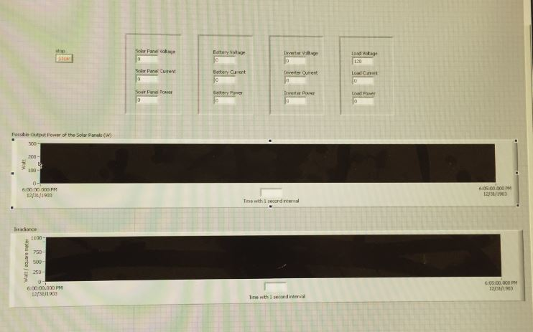

Slide 15
Simulation Image

Slide 16
Simulation testing
Used low irradiance, high temperature, high load to show how the system works
We then went through and simulated physical tests

Slide 17
Project extension
Our group has designed a lab document based on the solar PV system that can be used for ISU course in the future
Uses matlab/simulink
Step by step documentation to reproduce system
Assumes that the user has taken or is enrolled in EE452

Slide 18
Questions?

Slide 19
Thank You!

